Slide 1
Video Processing Techniques for Mirror Detection in Monocular Visual SLAM
Julianne Marie Ruz
2014-04280

Slide 2
Introduction
Mirrors are a common object in our environment. Hence robots must be able to recognize them to prevent property damage and damage to themselves.

Slide 3
Thesis Objective
The study aims to show that modified video processing techniques can be used to identify mirrors in visual SLAM.

Slide 4
Overview of important concepts and terms
Egomotion (Agrawal et al., 2015)
- an agent’s awareness of its own motion
Invariants (Cutting, 1986)
- anything left unaltered by coordinate transformation
Focus of expansion
- the point where optic flow seems to come from
Motion parallax
- change in object position due to change in viewer position

Slide 5
Overview of important concepts and terms
Simultaneous Localization and Mapping (S.L.A.M.) (Cadena et al., 2016)
- constructing a map while keeping track of the robot’s location
Visual S.L.A.M.
- S.L.A.M. with focus on the use of the camera sensor
Visual Odometry (O’Mahony et al., 2019)
- tracking the change in position over time using a stream of images

Slide 6
Methodology
Mirror Detection
SLAM Framework
Formation of the robot body

Slide 7
Mirror Detection
- most approaches to mirror detection use extra sensors or neural networks
- extra sensors like laser rangefinders are limited by the behavior of light (Koch et al., 2015)
- neural networks are expensive and might be overkill (Marcus, 2018)

Slide 8
Mirror Detection
The study will leverage the observable behavior of light to detect the mirror. It will also employ egomotion to gather information provided by invariants and motion parallax.
1. Set a main reference point (MRP)
2. Do the following for each frame:
- Separate the frame into the largest regions
- Segregate the largest contours in those regions into groups of shapes and compute their areas
- Track the growth and movement of the shapes

Slide 9
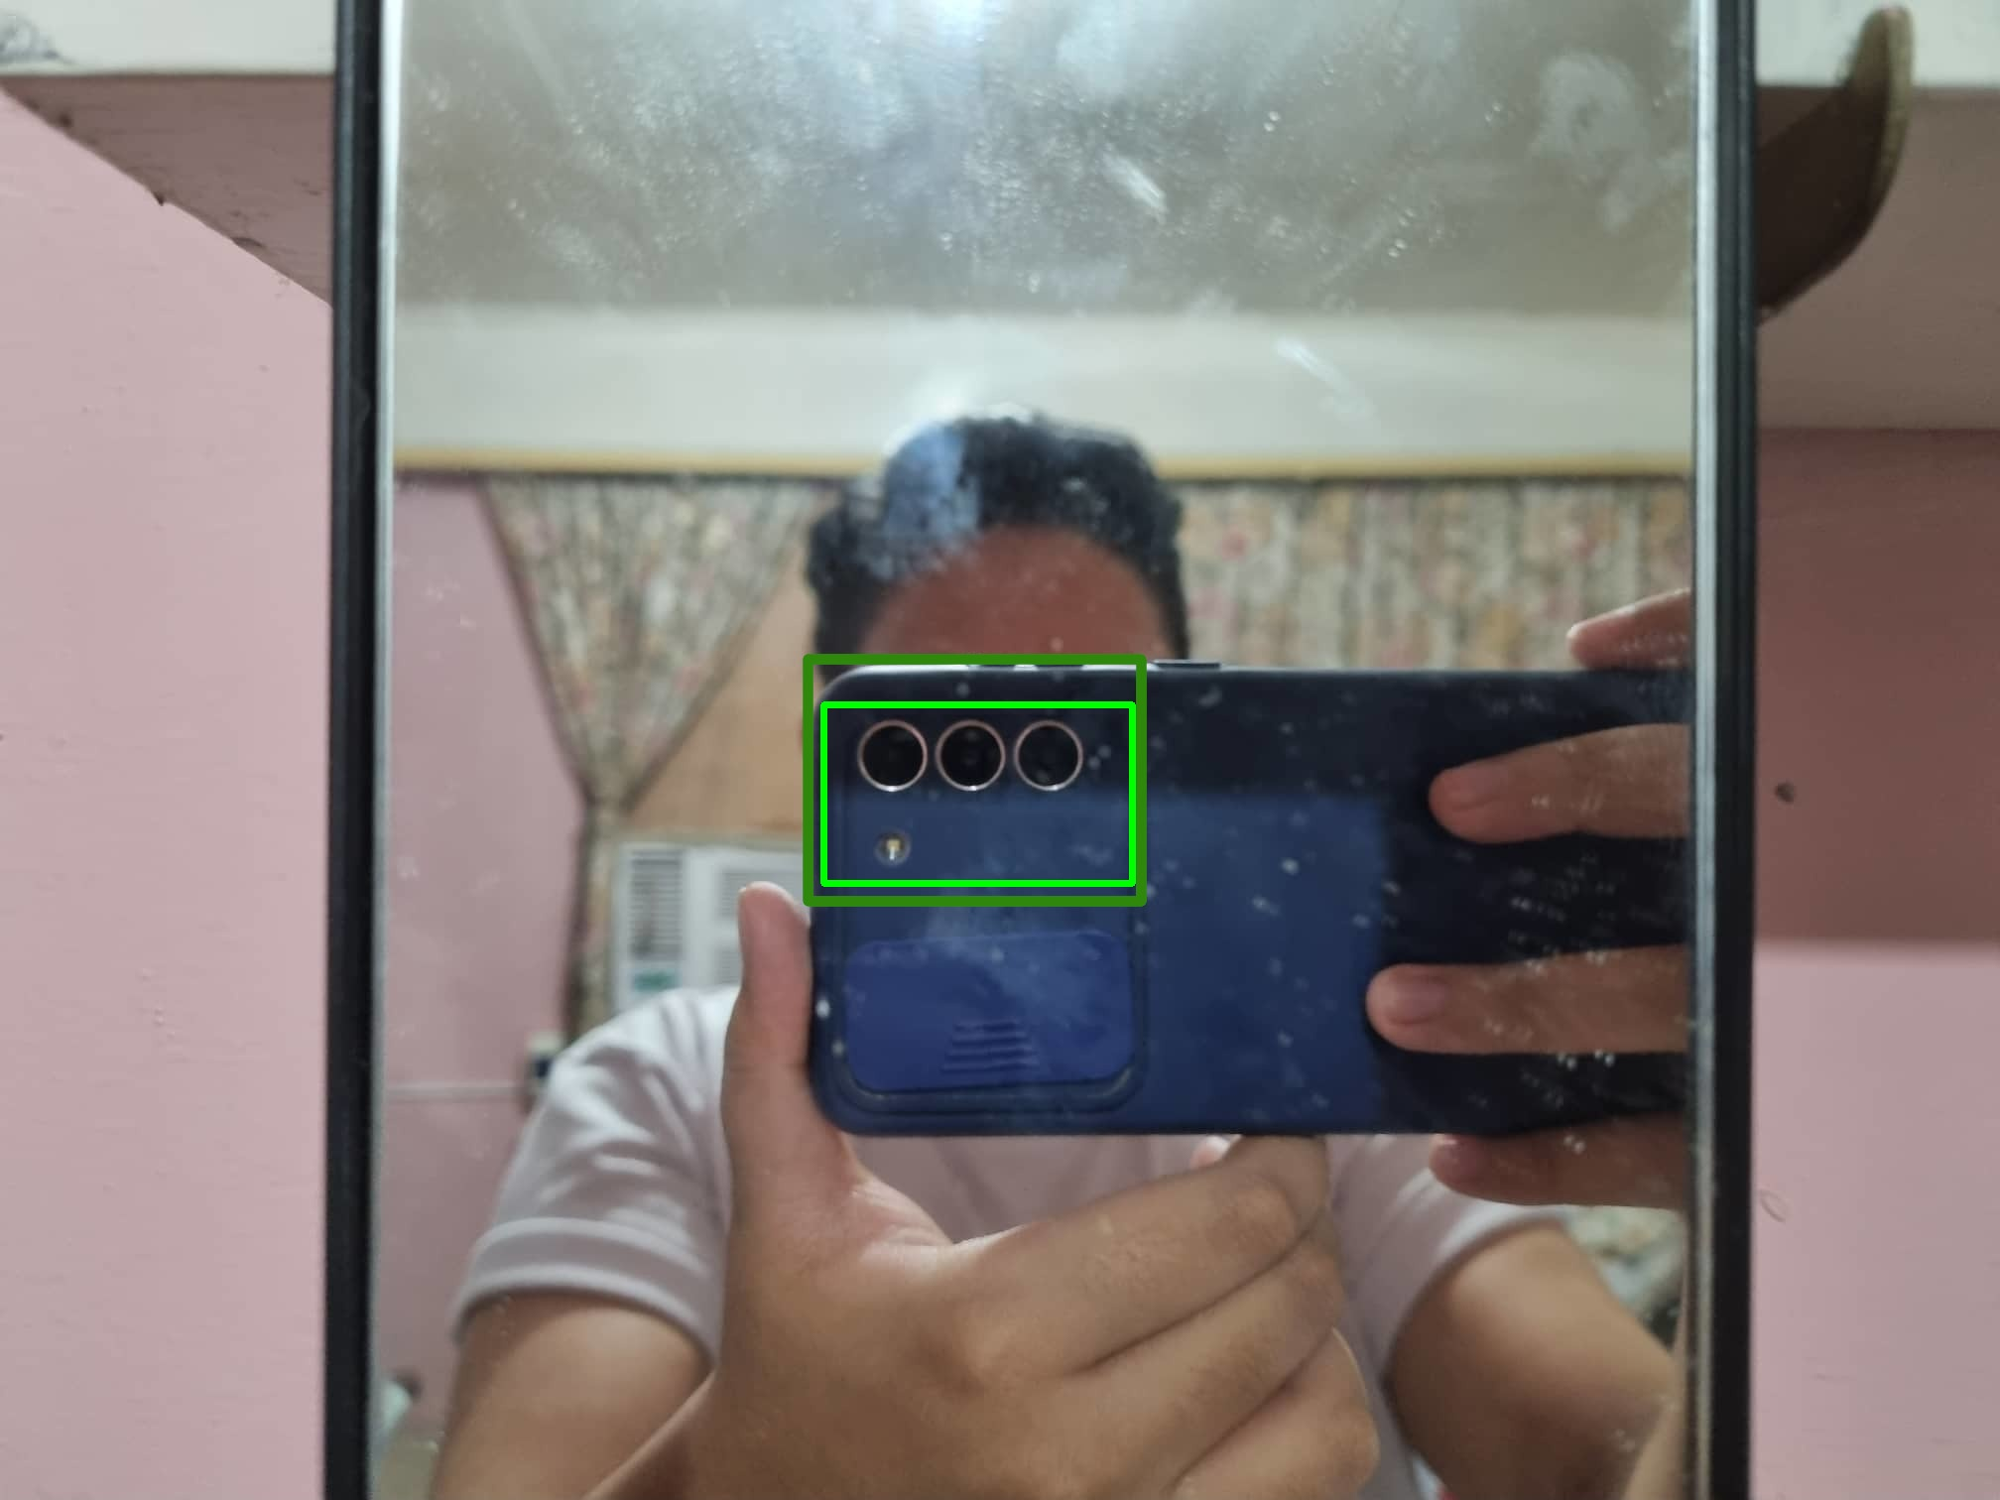
Successful mirror detection requirements
- if visible, the main reference point (MRP, outlined in green) will change/move in parallel with the robot
- auxiliary reference blobs (ARBs) will enter/exit the field of view
-ARBS will also change/move in parallel with the robot

Slide 10
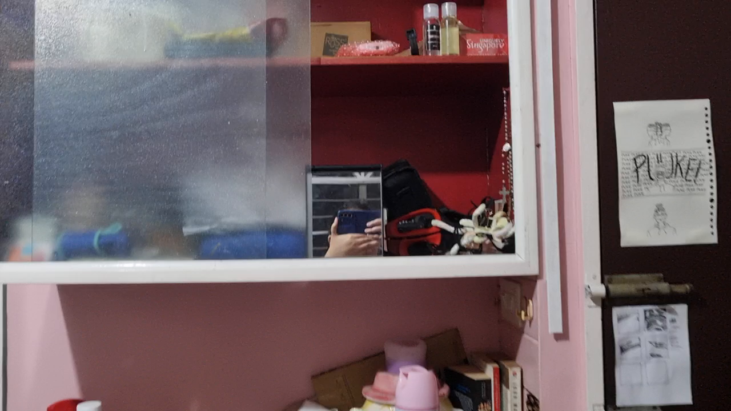
Mirror Detection

Slide 11
Extended Kalman Filter
- a heuristic for nonlinear filtering
- is more flexible than the Kalman filter that it inherits from because it approximates the belief expression (Thrun et al., 2006)

Slide 12
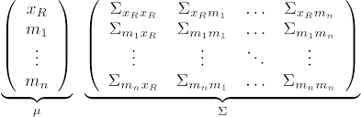
SLAM Framework
On the left is the state vector and on the right the covariance matrix. We’ll be working with this when applying the Extended Kalman filter to SLAM.

Slide 13
EKF SLAM Framework (Stachniss, 2013)
1. State prediction
- predict the next state and update the first 3 dimensions of the covariance matrix
2. Measurement prediction
- what the robot assumes to measure with the current information

Slide 14
EKF SLAM Framework
3. Measurement
- the obtained measurement is now the reality percieved by the robot. It will then map the measurement to a landmark and, if there are prior marked landmarks, compute the difference between it and the n-1th landmark
4. Data association
- update the mean vector, then update the covariance matrix
5. Update
6. Repeat

Slide 15
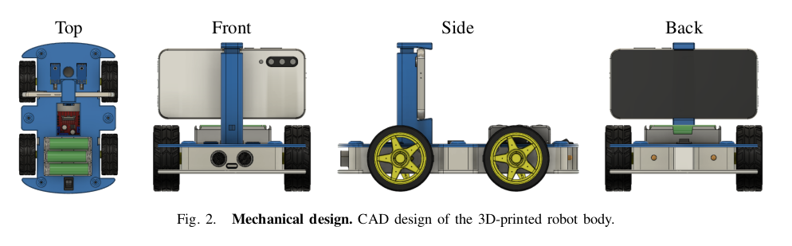
Robot body (Müller and Koltun, 2020)

Slide 16
Division of labor
Android
Run the SLAM framework
Graphical user interface
Video stream
Serial communication
Arduino
Motor control
Monitor battery
Measure wheel speed and RPM
Serial communication

Slide 17
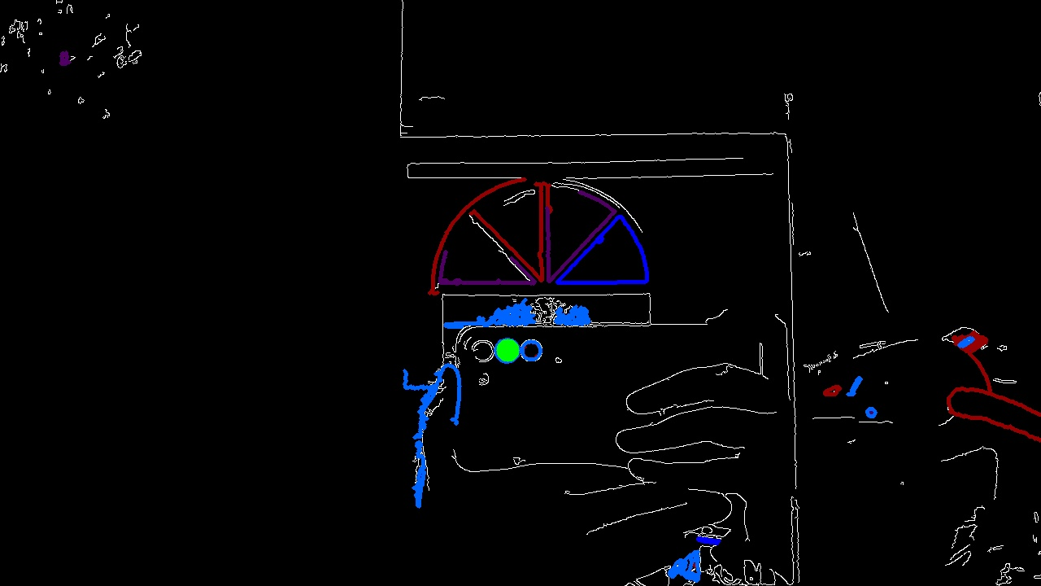
Initial results
Android
Basic GUI
Serial connection to Iduino Uno
Arduino
Code snippets for DC motor control via motor shield and servo motor
Serial connection to Android
Red - rectangles
Blue - triangles
Purple – polygons (5-9 sides)
Green – camera lens

Slide 18
References
Agrawal, P., Carriera, J., Malik, J. (2015). Learning to See by Moving [PDF]. 2015 IEEE International Conference on Computer Vision (ICCV), 2015, 37-45. DOI: 10.1109/ICCV.2015.13.
Cadena, C., Carlone, L., Carrillo, H. Latif, Y., Scaramuzza, D., Neira, J., Reid, I., Leonard, J.J. (2016). Past, Present, and Future of Simultaneous Localization and Mapping: Towards the Robust-Perception Age. [PDF]. IEEE Transactions on Robotics, 32(2016), 1309-1332. DOI: 10.1109/TRO.2016.2624754.
Cutting, J. (1986). Perception with an Eye for Motion [PDF]. Cambridge, Massachussetts: The MIT Press. Retrieved from http://cutting.psych.cornell.edu/pubs/Perception%20with%20an%20Eye%20for%20Motion.pdf.
Koch, R., May, S., Koch, P., Kuhn, M., Nuchter, A. (2015). Detection of Specular Reflections in Range Measurements for Faultless Robotic SLAM [PDF]. Robot 2015: Second Iberian Robotics Conference, Lisbon, Portugal. DOI: 10.1007/978-3-319-27146-0_11.

Slide 19
References
Marcus, G. (2018). Deep Learning: A Critical Appraisal [PDF]. Retrieved from https://arxiv.org/abs/1801.00631v1.
Müller, M. and Koltun, V. (2020). OpenBot: Turning Smartphones into Robots. [ebook] Available at: <https://arxiv.org/abs/2008.10631> [Accessed 1 September 2022].
O’ Mahony, N., Campbell, S., Carvalho, A., Harapanahalli, S., Hernandez, G.V., Krpalkova, L., Riordan, D., Walsh, J. (2019). Deep Learning vs. Traditional Computer Vision [PDF]. Computer Vision Conference (CVC) 2019, Las Vegas, Nevada, United States. DOI: 10.1007/978-3-030-17795-9_10.
Stachniss, C. (2013) SLAM Course – 05 – EKF SLAM (2013/14; Cyrill Stachniss) [Video]. Youtube. https://www.youtube.com/watch?v=XeWG5D71gC0&ab_channel=CyrillStachniss.
Thrun, S., Burgard, W. and Fox, D., 2006. Probabilistic Robotics. [ebook] The MIT Press. Available at: <https://github.com/liulinbo/slam/blob/master/Probabilistic%20Robotics%20_Sebastian%20Thrun%20et%20al..pdf>.

